Slide 1
Multiplayer Quiz Game
– Sean Meyer

Slide 2
Program Structure
Client
Runs GUI and handles communication with server. Can launch server
ServerConnection
Wrapper for the server socket and data streams from the server, provides helper functions
Server
Handles 4 clients at a time, selects questions to send, processes answers, and tracks player scores
ClientConnection
Wrapper for client socket and data streams from the client, allows score tracking and other helper functions
Question
Simple data structure with helpful functions to model a quiz question in memory

Slide 3
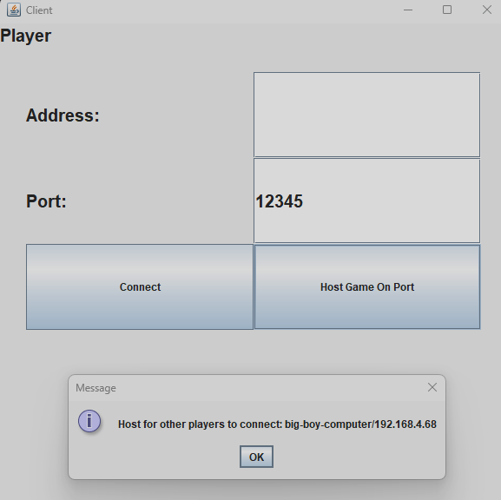
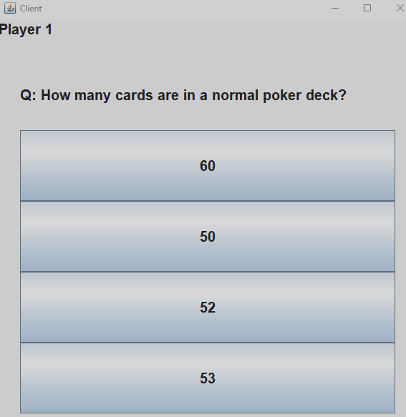
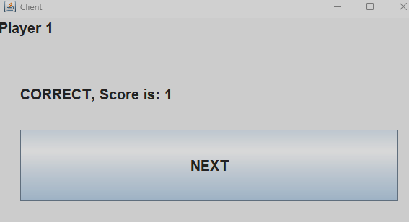
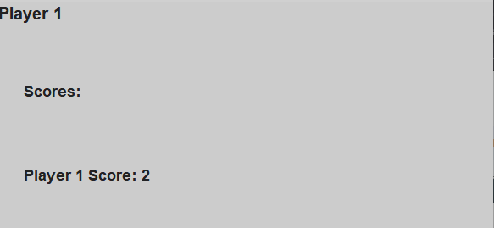
GUI
GUI is comprised of multiple “cards”
Each card is shown once the server sends the information needed to display it
“Modern” UI with Java Swing

Slide 4
How Multiple Clients are Handled
When a client attempts to connect with the server, the server gives the client a unique socket
An array of ClientConnection will give each client a unique socket to talk over
Server can loop through the ClientConnection array to send and receive data
Upon connection, each client is sent a player number for tracking

Slide 5
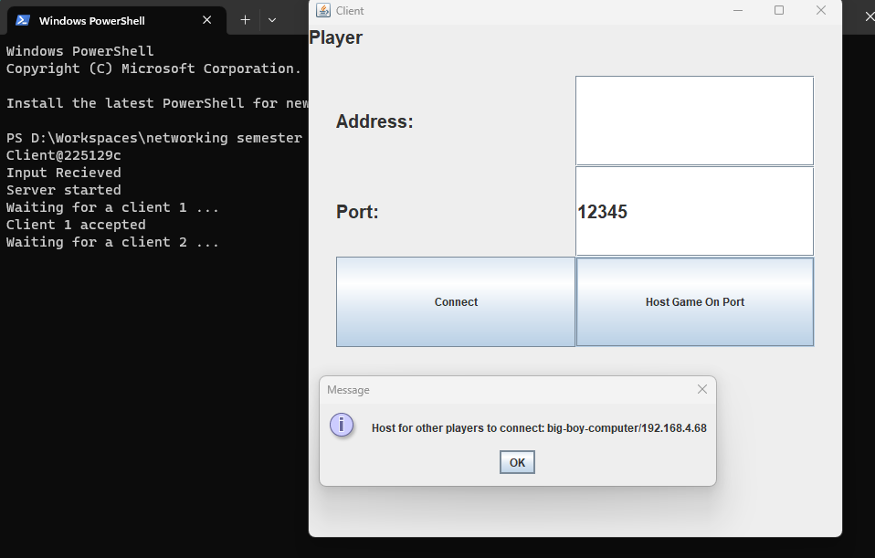
How a Server is Started
Player enters the port they wish to run the game on
When they hit “Host Game On Port” the client runs a server on another thread
Once the server is started, the client will inform the player that started the server what their IP is
The player can share the IP displayed and the port for others to join
The port the server is started on is only used for connecting, once connected clients are moved to another port

Slide 6
Walking Through a Game
Once all players are connected and have a player number, they wait for the server
Server sends a question, then all players may answer.
Once all players answer, the server will validate the answers and send back the results
This repeats for all 15 questions
After the last question, all scores are sent to all players to be displayed on a final screen

Slide 7
Future Work
Track the time it takes to answer a question for a more fast paced game
Add a lobby to display who is in the game
Add username customization
Allow the game to be run with any number of players
Add more multithreading to avoid UI freezes

